Slide 1

语音识别深度序列建模及解码
陈哲怀
chenzhehuai@sjtu.edu.cn
导师：俞凯
副导师：钱彦旻
SpeechLab, Brain-like Computing and Machine Intelligence (BCMI)
Department of Computer Science & Engineering
Shanghai Jiao Tong University
Notes:
Noise robustness and computational overhead are two main bottlenecks in the wide application of speech recognition systems. In this talk, we discuss about both of them in some perspectives I used to conduct researches on.

Slide 2
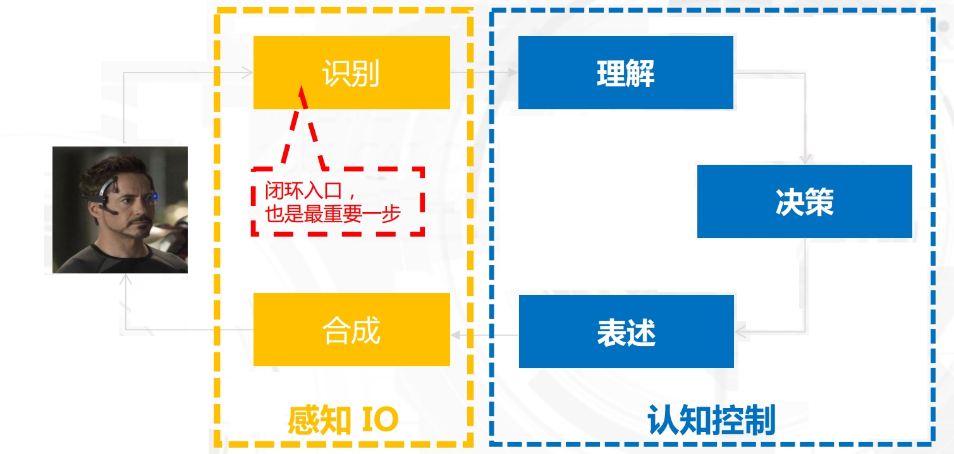
自动语音识别
Notes:
Speech recognition is the first stage of the human machine interaction. Its outputs are always followed by spoken lang understanding.

Slide 3
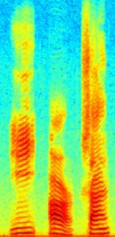
自动语音识别
K + AA1 + R
CAR
Notes:
Speech recognition system always contains 3 parts, am, lm and decoding. Acoustic model is to map feature seq to phone seq, and langua model is to map phone seq to word seq

Slide 4
提纲
课题背景
语音识别中的序列建模
语音识别中的搜索解码
无词图的序列鉴别性训练
并行化的搜索解码算法
标签同步的搜索解码算法

Slide 5
提纲
课题背景
语音识别中的序列建模
语音识别中的搜索解码
无词图的序列鉴别性训练
并行化的搜索解码算法
标签同步的搜索解码算法

Slide 6
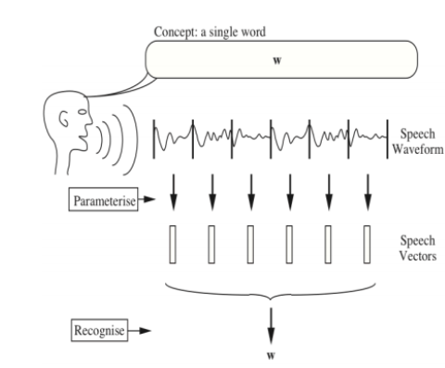
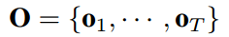
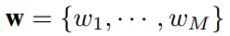
语音识别任务
输入: 实数序列
特征提取: 实数向量序列
输出: 词语序列
Notes:
for exp this one
the problem is we have several speech and they are mixed together like this【】
and we wanna obtain all transcripts from that
N is the speaker【】
what we interested is the transcriptions of all people

Slide 7
语音识别任务
输入: 实数序列
特征提取: 实数向量序列
输出: 词语序列
难点
语音变长：序列分段、状态对齐
语音信号非线性：模式分类
系统功耗：搜索解码
Notes:
for exp this one
the problem is we have several speech and they are mixed together like this【】
and we wanna obtain all transcripts from that
N is the speaker【】
what we interested is the transcriptions of all people

Slide 8
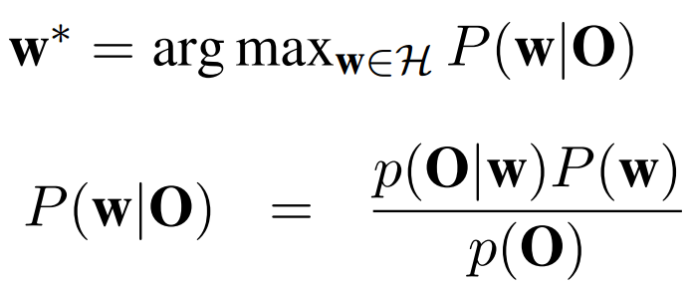
基于统计的语音识别框架
基本公式
核心问题
建模
分类器：语音信号非线性
序列建模：语音变长
搜索解码：实际达到的速度和精度
深度学习
Notes:
for exp this one
the problem is we have several speech and they are mixed together like this【】
and we wanna obtain all transcripts from that
N is the speaker【】
what we interested is the transcriptions of all people

Slide 9
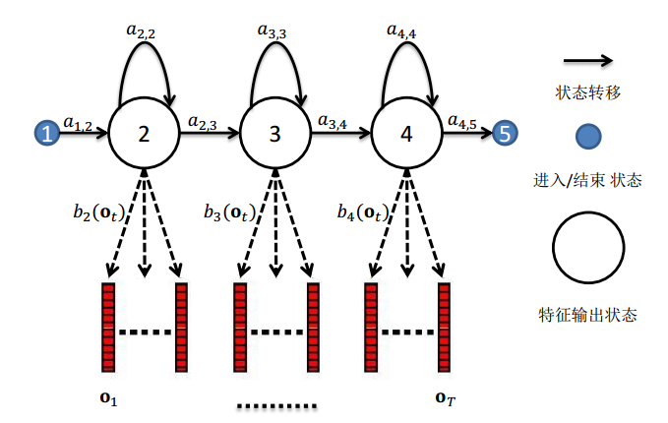
语音识别中的隐马尔科夫模型
用于建模每一个声学单元
三音素tri-phone
状态转移概率
状态输出概率
Notes:
for exp this one
the problem is we have several speech and they are mixed together like this【】
and we wanna obtain all transcripts from that
N is the speaker【】
what we interested is the transcriptions of all people

Slide 10
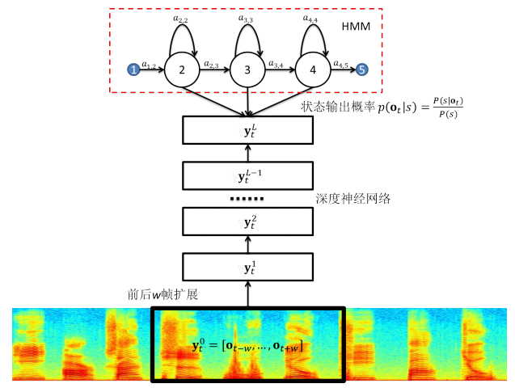
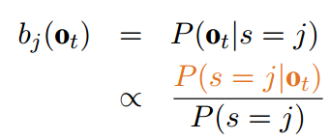
基于深度学习的语音识别
分类器：6 隐层深度前馈网络
建模：后验概率
特征窗口
参数共享
Notes:
for exp this one
the problem is we have several speech and they are mixed together like this【】
and we wanna obtain all transcripts from that
N is the speaker【】
what we interested is the transcriptions of all people

Slide 11
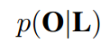
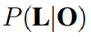
语音识别的序列建模
语音变长：序列分段、状态对齐 → 序列预测问题
帧级别准则→序列级准则
框架一：序列鉴别性训练
框架二：鉴别式序列模型
K + AA1 + R
Notes:
for exp this one
the problem is we have several speech and they are mixed together like this【】
and we wanna obtain all transcripts from that
N is the speaker【】
what we interested is the transcriptions of all people

Slide 12
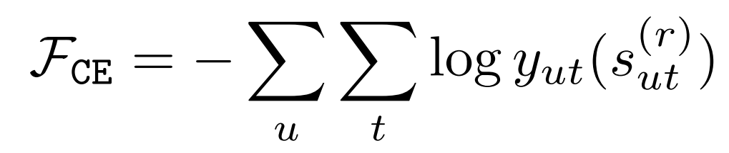
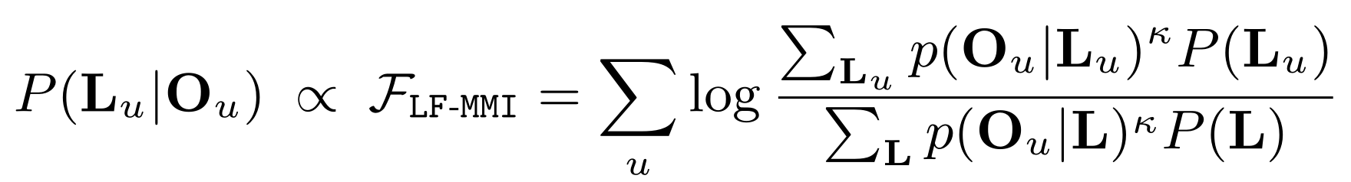
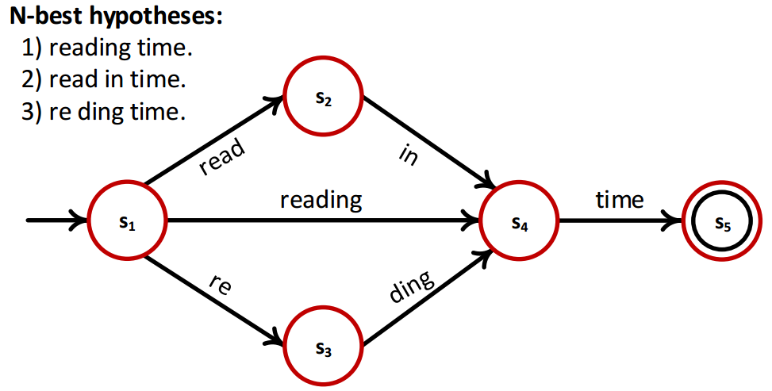
框架一：序列鉴别性训练
初衷
帧级别准则→序列级准则
声学模型
语言模型
词图
P(O_{u})
Notes:
the motivation of disc tr is to change the frame level criterion to sequential crit
namely the frame level CE is changed to a sequence posterior based disc tr crit
by applying bayesian formula, it change to the nominator and denominator here
it includes am and lm
the denominator is to model the P(O) by maginal prob
this maginal prob is regarding to the whole search space, we always use lattice like this
by this way, we optimize the 1best result in nominator, while we penalize the nbest results in denominator

Slide 13
框架一：序列鉴别性训练
缺点
词图构建慢
逐句词图导致训练难以并行
需要好的初始化
针对其它非传统识别任务的序列建模研究不充分
关键词检测
多说话人重叠语音识别
Notes:
for exp this one
the problem is we have several speech and they are mixed together like this【】
and we wanna obtain all transcripts from that
N is the speaker【】
what we interested is the transcriptions of all people

Slide 14
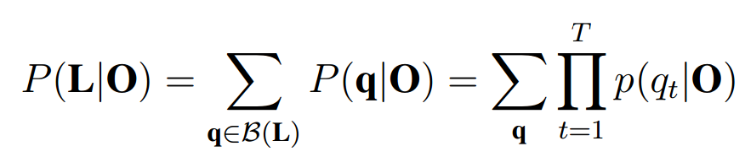
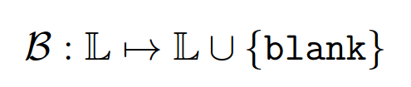
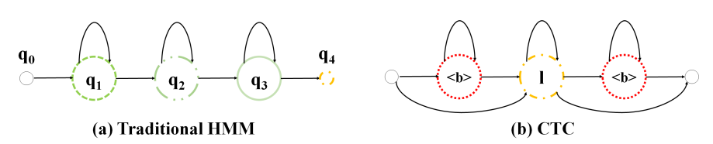
框架二：鉴别式序列模型
连接时序分类模型
缺点
需要大量数据
自适应难，不鲁棒
Notes:
for exp this one
the problem is we have several speech and they are mixed together like this【】
and we wanna obtain all transcripts from that
N is the speaker【】
what we interested is the transcriptions of all people

Slide 15
提纲
课题背景
语音识别中的序列建模
语音识别中的搜索解码
无词图的序列鉴别性训练
并行化的搜索解码算法
标签同步的搜索解码算法

Slide 16
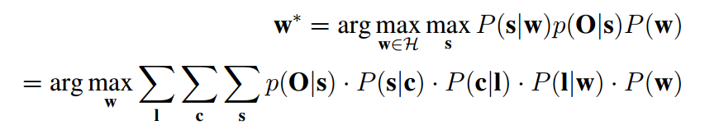
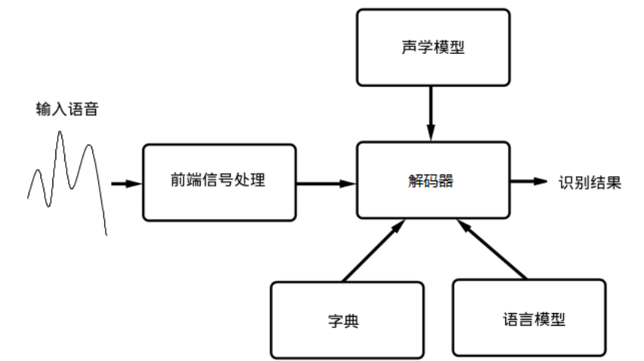
语音识别中的搜索解码
声学模型
上下文相关模型
语言模型
隐马尔科夫模型模型
词典
Notes:
for exp this one
the problem is we have several speech and they are mixed together like this【】
and we wanna obtain all transcripts from that
N is the speaker【】
what we interested is the transcriptions of all people

Slide 17
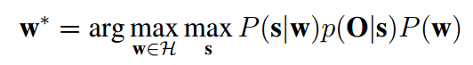
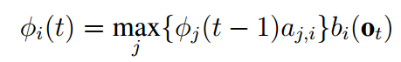
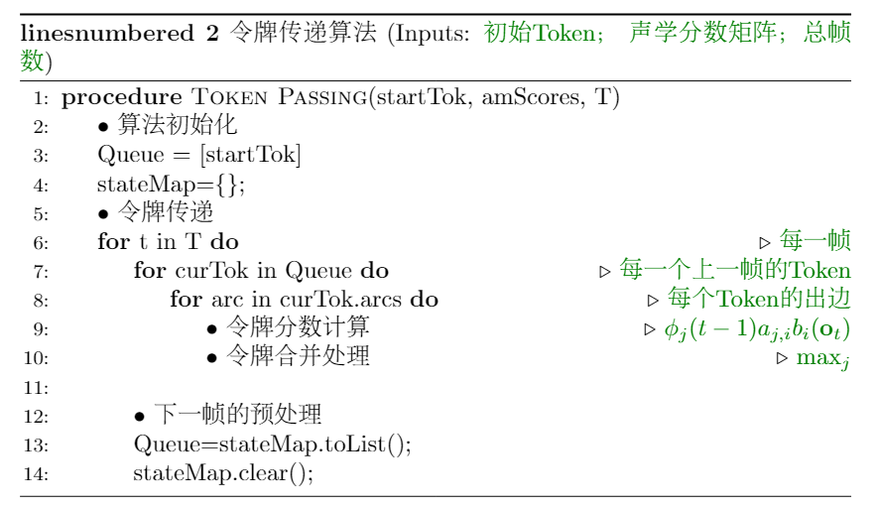
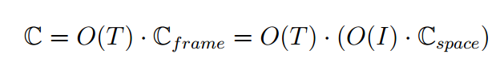
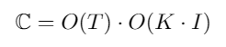
语音识别中的搜索解码
动态规划（维特比）算法
状态的入度
保留令牌数
Notes:
for exp this one
the problem is we have several speech and they are mixed together like this【】
and we wanna obtain all transcripts from that
N is the speaker【】
what we interested is the transcriptions of all people

Slide 18
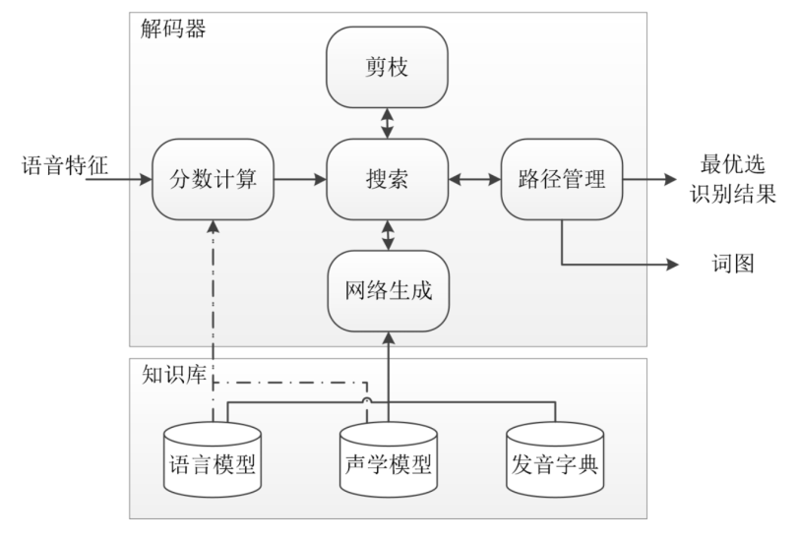
语音识别中的搜索解码
流派分类
动态和静态网络生成（空间换时间）
异步和同步搜索算法（深度v.s.广度优先）
单遍和多遍解码
Notes:
for exp this one
the problem is we have several speech and they are mixed together like this【】
and we wanna obtain all transcripts from that
N is the speaker【】
what we interested is the transcriptions of all people

Slide 19
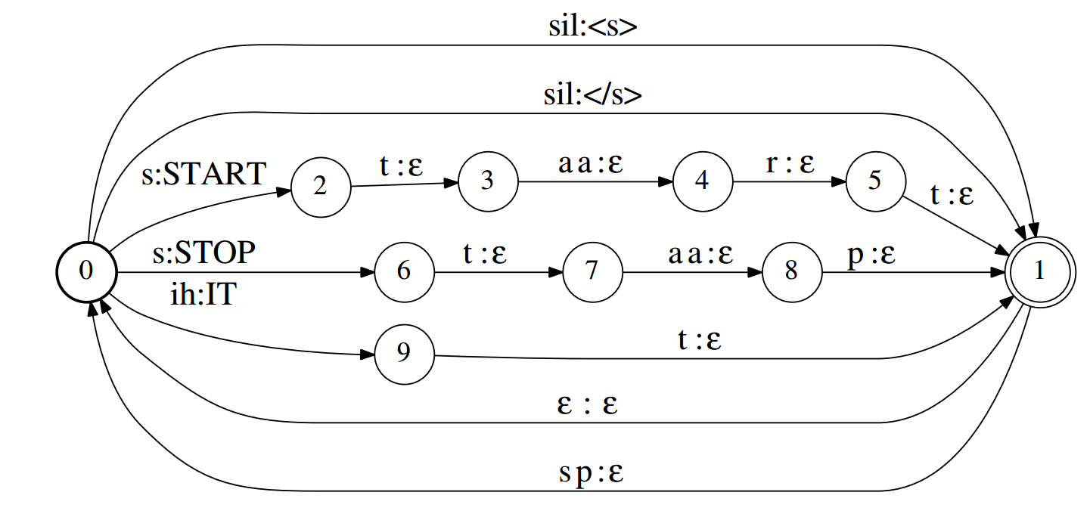
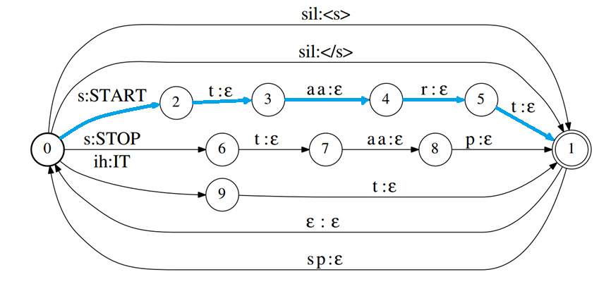
基线解码算法
Weighted finite state transducer (WFST)
word | Pronunciation | Score¹
<s> | sil | 0.1
</s> | sil | 0.6
START | s t aa r t | 0.5
STOP | s t aa p | 0.4
IT | ih t | 0.3
每条边都有相应权重. 这里没有绘制出来
通常有百亿条边
Notes:
the latter process is done by WFST decoding. e.g., we have a lexicon like this and the langu model also gives some score for each word. Then we can express all these info as a graph.
【】Then the final problem becomes obtaining the best path in the graph, which is done by Viterbi decoding.

Slide 20
基线解码算法
词图处理
词图重估
置信度
混淆网络生成
etc.
鉴别性训练
Notes:
after decoding, we can obtain a nbest hypotheses list,
e.g. reading ..., read ...
and we can transfer it to a graph like this, as there are some common parts in the hypotheses, e.g. this "time"【】
It's called lattice.
After obtaining lattice, we can do several things 【】 Thus lattice processing is the common setup in ASR systems.
btw, this work can speed up all of these application by speeding up the decoding

Slide 21
搜索解码研究
传统研究点
WFST optimization
加速分数计算（并行、简化）
剪枝和分数预测
词图
置信度
缺点
未结合序列建模研究
无整体并行方案
深度学习
GPU/FPGA
Notes:
for exp this one
the problem is we have several speech and they are mixed together like this【】
and we wanna obtain all transcripts from that
N is the speaker【】
what we interested is the transcriptions of all people

Slide 22
提纲
课题背景
语音识别中的序列建模
语音识别中的搜索解码
无词图的序列鉴别性训练
并行化的搜索解码算法
标签同步的搜索解码算法

Slide 23
序列鉴别性训练
帧级别准则→序列级准则
声学模型
语言模型
词图
P(O_{u})
Notes:
the motivation of disc tr is to change the frame level criterion to sequential crit
namely the frame level CE is changed to a sequence posterior based disc tr crit
by applying bayesian formula, it change to the nominator and denominator here
it includes am and lm
the denominator is to model the P(O) by maginal prob
this maginal prob is regarding to the whole search space, we always use lattice like this
by this way, we optimize the 1best result in nominator, while we penalize the nbest results in denominator

Slide 24
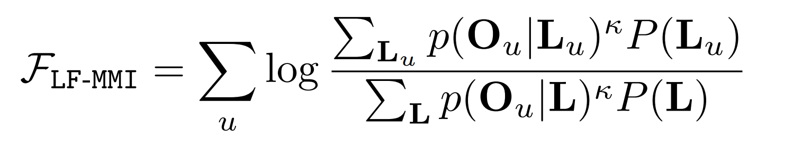
无词图鉴别性训练
帧级别准则→序列级准则
无词图鉴别性训练的初衷
大规模并行计算 → 更多训练数据 (性能更好)
纯粹序列建模准则 (性能更好)
更低帧率，不需要初始化，不需要词图生成 (速度更快)
etc.
逐句词图 → 统一语言模型

Slide 25
无词图鉴别性训练的实现
微软版本 v.s. Kaldi版本
Tri-phone state 语言模型 v.s. 音素语言模型
在LVCSR任务上取得了好的性能
逐句词图 → 统一语言模型

Slide 26

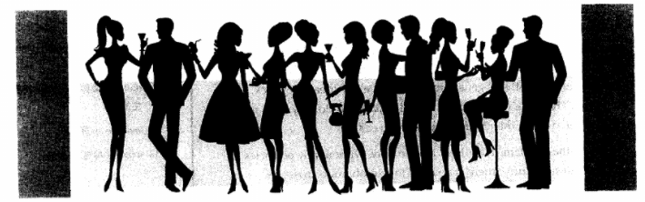
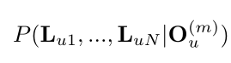
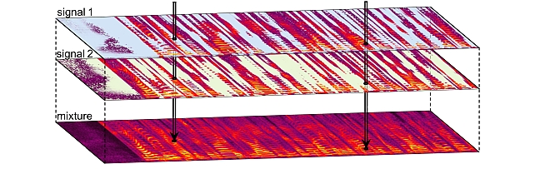
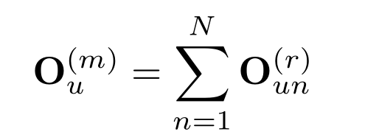
多说话人重叠语音信号识别
鸡尾酒会问题
N=2
Notes:
for exp this one
the problem is we have several speech and they are mixed together like this【】
and we wanna obtain all transcripts from that
N is the speaker【】
what we interested is the transcriptions of all people

Slide 27
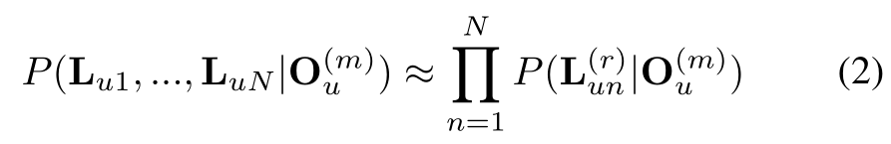
Assignment error:
e.g. ch-a: how oh you
ch-b: are no
Cross talk error:
e.g. ch-a: how are you
ch-b: oh are no
标签分配（label assignment）问题
两对标签不相关
n=1
n=2
Notes:
we can assume label sequences are indep with each other, like this
then there is a problem about label assignment, 【how to assign labels belonging the same speaker together】. else we will get these kinds of errors

Slide 28
排列不变性训练 （ Permutation Invariant Training , PIT）
Notes:
PIT is proposed to solve this problem.
we have two label seq and two predictions【】
PIT is the criterion

Slide 29
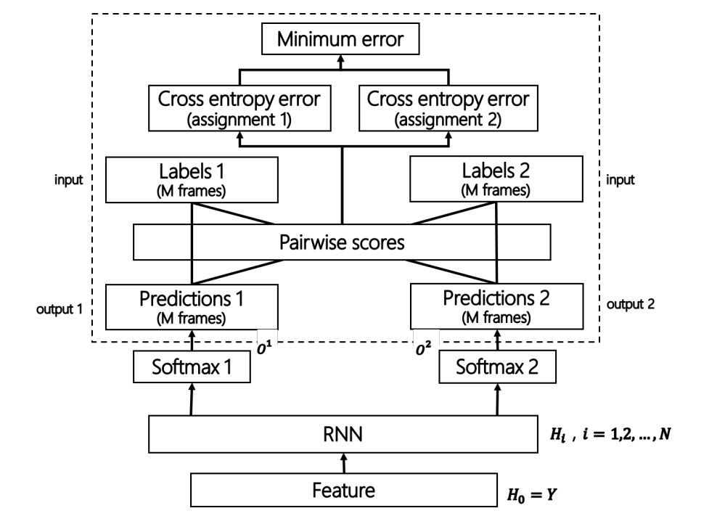
Permutation Invariant Training for ASR
Notes:
it calculate errors of all possible assignment【fig】
so it's 1 1 2 2 and 1 2 2 1
and then choose the smallest error to do optimization
after the training, the model can spontaneously inference the same speaker's words from the same output

Slide 30
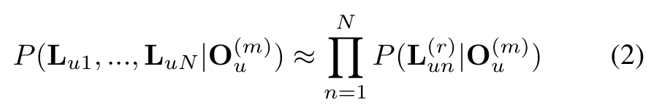
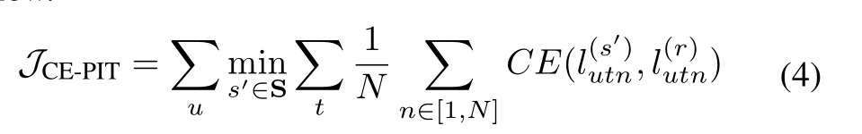
Permutation Invariant Training for ASR
缺点
模型建模难度大
帧级别准则 → 序列级问题
未考虑语言学知识
目前结果
WER 50+% → 两个词中错一个
Notes:
although it's a correct critierion, the disadv of pit includes
i) the model is too complex
ii) it uses a frame-wise criterion to solve a sequence level prob
iii) linguistics is also important in this task

Slide 31
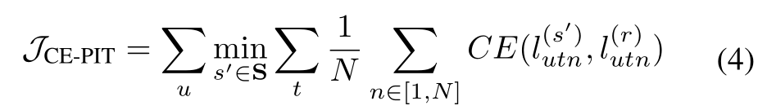
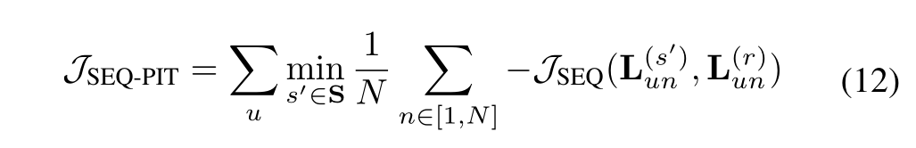
多输出的鉴别性训练方法
初衷
语音识别和语音分离都是序列级问题
隐含地将语言模型融合到系统中
公式修改
Notes:
similarly in cocktail party prob, we change the frame lev CE to seq level disc tr crit. One explicit diff is here we have multi outputs

Slide 32
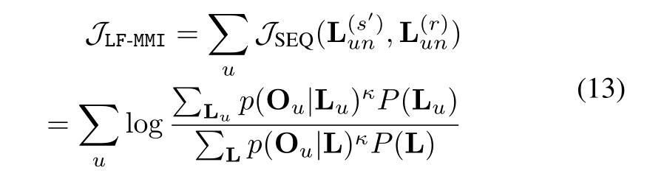
多输出的鉴别性训练方法
Hypothesis Modeling
Search space modeling
ASR Insertion
ASR Deletion
ASR substitution
Assignment error
e.g. ch-a: how oh you
ch-b: are no
Cross talk error
e.g. ch-a: how are you
ch-b: oh are no
Notes:
Thus we mainly need to solve the diff way of hyp modeling
THe problem is how we model the L in denominator
recalling that we always model it by a lattice, the lattice contains normal ASR errors, that is ins del sub.
BUT, it does not include specific errors in this prob here, e.g. this how are you is switched

Slide 33
多输出的鉴别性训练方法
ASR Insertion
ASR Deletion
ASR substitution
Assignment error
e.g. ch-a: how oh you
ch-b: are no
Cross talk error
e.g. ch-a: how are you
ch-b: oh are no
Hypothesis Modeling
Search space modeling
Problem: re-generate lattice
Method: Lattice-free ^{[1]}
[1] Povey D, Peddinti V, Galvez D, et al. Purely Sequence-Trained Neural Networks for ASR Based on Lattice-Free MMI[C] Interspeech. 2016: 2751-2755.
Notes:
so the first prob is how we generate lattice. as the permutation will change during the model training, we have to regenerate lattice once the permu is changed. Otherwise the quality of lattice is bad. We solve this prob by the lattice-free framework proposed by Daniel Povey

Slide 34
多输出的鉴别性训练方法
ASR Insertion
ASR Deletion
ASR substitution
Assignment error
e.g. ch-a: how oh you
ch-b: are no
Cross talk error
e.g. ch-a: how are you
ch-b: oh are no
Hypothesis Modeling
Search space modeling
Swapped word modeling
Notes:
The second prob is te most important. i.e. normal lattice does not contain these two errors

Slide 35
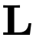
多输出的鉴别性训练方法
ASR Insertion
ASR Deletion
ASR substitution
Assignment error
e.g. ch-a: how oh you
ch-b: are no
Cross talk error
e.g. ch-a: how are you
ch-b: oh are no
Hypothesis Modeling
Search space modeling
Swapped word modeling
Problem: doesn’t contain swapped words
Notes:
and if so, the deno will be underestimate and the nomi will be overestimate
it means that after training, the model will always infer these kinds of errors

Slide 36
多输出的鉴别性训练方法
ASR Insertion
ASR Deletion
ASR substitution
Assignment error
e.g. ch-a: how oh you
ch-b: are no
Cross talk error
e.g. ch-a: how are you
ch-b: oh are no
Hypothesis Modeling
Search space modeling
Swapped word modeling
Problem: doesn’t contain swapped words
Method 1: artificial swapped words in LM
Notes:
a simpest way to solve this is by artifi swap some words in the language model in denominator
however of course it is inefficient as we cannot model all of them

Slide 37
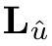
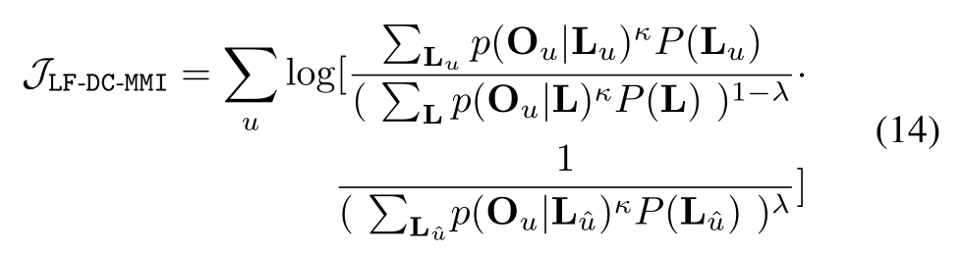
多输出的鉴别性训练方法
ASR Insertion
ASR Deletion
ASR substitution
Assignment error
e.g. ch-a: how oh you
ch-b: are no
Cross talk error
e.g. ch-a: how are you
ch-b: oh are no
Hypothesis Modeling
Search space modeling
Swapped word modeling
Problem: doesn’t contain swapped words
Method 1: artificial swapped words in LM
Method 2: add into
Notes:
we propose a better method by changing the denominator term in the formula
here we make the seq we are optimized as U1, and the other speech from another speaker is U2. then we penalize in deno both the normal ASR errors, and also the U2 from another speaker.

Slide 38
多输出的鉴别性训练方法
ASR Insertion
ASR Deletion
ASR substitution
Assignment error
e.g. ch-a: how oh you
ch-b: are no
Cross talk error
e.g. ch-a: how are you
ch-b: oh are no
Hypothesis Modeling
Search space modeling
Swapped word modeling
Problem: doesn’t contain swapped words
Method 1: artificial swapped words in LM
Method 2: add into
Notes:
thus we add another term in the deno here. It can solve this prob well

Slide 39
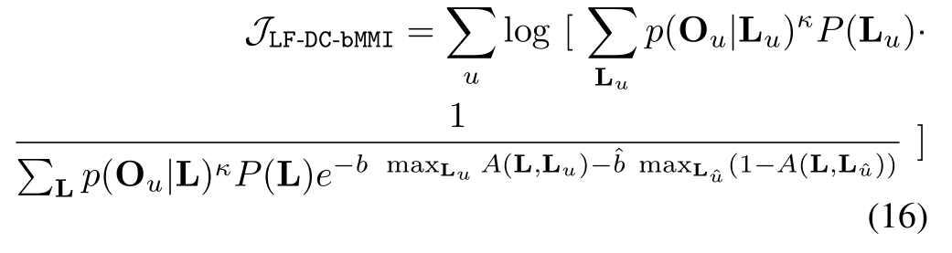
多输出的鉴别性训练方法
ASR Insertion
ASR Deletion
ASR substitution
Assignment error
e.g. ch-a: how oh you
ch-b: are no
Cross talk error
e.g. ch-a: how are you
ch-b: oh are no
Hypothesis Modeling
Search space modeling
Swapped word modeling
Problem: doesn’t contain swapped words
Method 1: artificial swapped words in LM
Method 2: add into
Method 3: boost errors of (bMMI)
Notes:
another way of thinking is inspired from boosted MMI, and the result is similar

Slide 40
实验结果
实验配置
人工重叠的SWBD数据集 300小时→150小时 (→50小时); hub5e-swb 1831 → 915句
9000 senones; clean speech alignment;
基线 1: 10L 768 cells BLSTM PIT-ASR 模型
基线 2: 6L 768 cells BLSTM PIT-SS + 4L 768 cells BLSTM ASR模型

Slide 41
系统介绍
声学改进
Modular Initialization + CNN
Transfer Learning Based Joint Training
Temporal Correlation Modeling
语言学改进
Multi-outputs Sequence Discriminative Training
Integrating Language Model in Assignment Decision
Zhehuai Chen, Jasha Droppo, Jinyu Li, Wayne Xiong, Progressive Joint Modeling in Unsupervised Single-channel Overlapped Speech Recognition. IEEE/ACM Transactions on Audio, Speech, and Language Processing, vol. 26, no. 1, pp. 184-196, Jan. 2018. doi: 10.1109/TASLP.2017.2765834.
Zhehuai Chen, Jasha Droppo, Sequence Modeling in Unsupervised Single-channel Overlapped Speech Recognition, IEEE International Conference on Acoustics, Speech and Signal Processing(ICASSP), Calgary, Canada, 2018.
Notes:
the seq disc tr can be combined with other techniqs we propose. And more details can be referred to these two papers

Slide 42
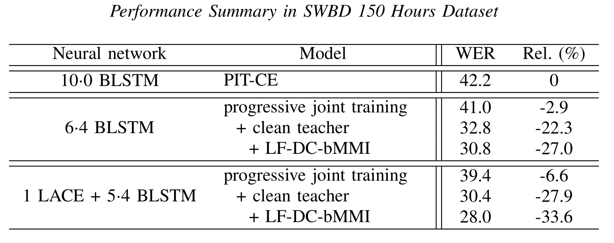
实验结果
在一个很强的迁移学习系统上
取得 6.1%&7.9% 相对改善

Slide 43
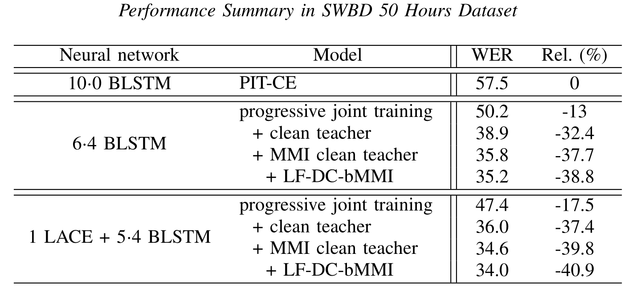
实验结果
甚至能改善MMI的教师模型

Slide 44
例子（ 50小时 女声-女声）
Clean ASR (90+WER)
1 PIT-CE
2 Transf.
3 +MMI teacher
4 +seq. disc. tr.
Notes:
M-F sw_4484_A_125400000_275200000_sw_4560_A_1298300000_1453400000
M-F sw_4520_B_735100000_882700000_sw_4543_B_0_148200000
M-M sw_4520_B_1659700000_1804200000_sw_4537_B_2288500000_2434400000
M-M sw_4601_A_2244300000_2388200000_sw_4560_A_997300000_1141500000
F-F sw_4776_A_385900000_525700000_sw_4854_B_475700000_615900000
\\jdroppo-z820\hpv\data_prep\eval2000-sorted_overlapped\WAV
REDMOND.t-zhehch@GCRGDL106:/msr-hdp-gw0015/Scratch/jdroppo/t-zhehch/decode$ bash get_hyps.sh > csv/exp.txt
awk -v dn=10000000 -v na=sw_4520_B_1659700000_1804200000_sw_4537_B_2288500000_2434400000 'function gn(nai,ad){split(nai,a,"_");ur=a[1+ad]"_"a[2+ad]" "a[3+ad]" "a[1+ad]"_"a[2+ad]"_"a[3+ad]" "a[4+ad]/dn" "a[5+ad]/dn;return ur}BEGIN{u1=gn(na,0);u2=gn(na,5);}NR==FNR{if($3==pr){n++}else{pr=$3;n=0}if ($0~u1||$0~u2){printf "%s-%03i\n",tolower($3),n}}' score_tmp/refs/hub5e00.english.000405.stm | awk 'NR==FNR{a[FNR]=$0;}NR!=FNR{if ($0~"id: "){if ($0~a[1]||$0~a[2]){p=1}else{p=0}}if (p==1){print}}' - rsts/application_1498589312003_8256.cnn.cnn.lfmmi2.nb0.3.dnn.24.150.dnn.11.0_fmix80/ac.0.067/final/rearrange.mlf.ctm.pra

Slide 45
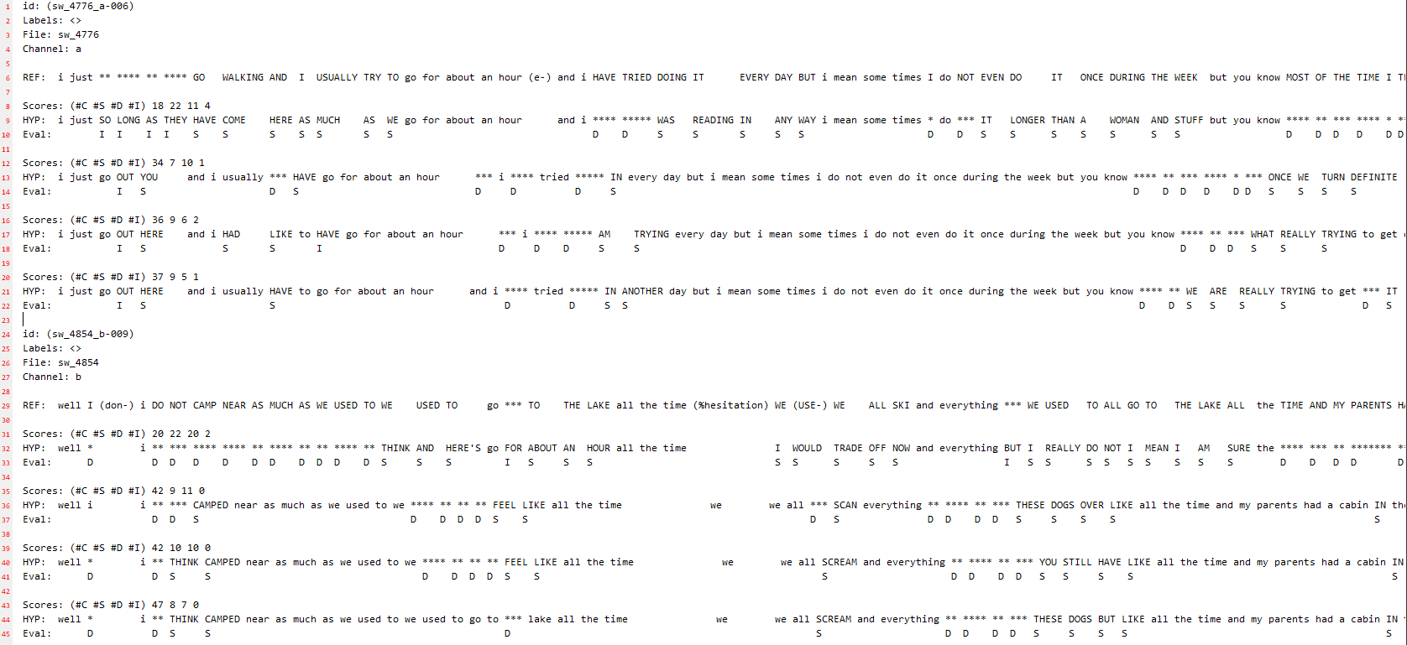
1 PIT-CE
2 Transf.
3 +MMI teacher
4 +seq. disc. tr.
更少语法错误（更好的语言学建模）
更少删除错误（更好的语音分离）

Slide 46
提纲
课题背景
语音识别中的序列建模
语音识别中的搜索解码
无词图的序列鉴别性训练
并行化的搜索解码算法
标签同步的搜索解码算法

Slide 47
语音识别中的搜索解码
语音识别系统分解
K_B + AA1_I + R_E
超过 50% 计算时长
40倍加速或
10倍费用节省
CAR
Notes:
Speech recognition system always contains 3 parts, am, lm and decoding. Acoustic model is to map feature seq to phone seq, and langua model is to map phone seq to word seq
Usually, the latter process 【】 takes over 50% of the time
and this work achieves a significant speedup on it

Slide 48
加速思路
搜索解码优化
减少 搜索复杂度
End-to-end Modeling
K + AA1 + R
CAR
/ C + A + R
Notes:
our first idea is to reduce the search comp by end-to-end modeling
namely, if we can model the word sequence directly instead of modeling the phone sequence, e.g. we directly model the word "car", then we can reduce the search complexity from phone sequence to word sequence.
//Meanwhile, if we can change to model the character, e.g. we model C A R here, then the search complexity from C A R to CAR is also greatly reduced.

Slide 49
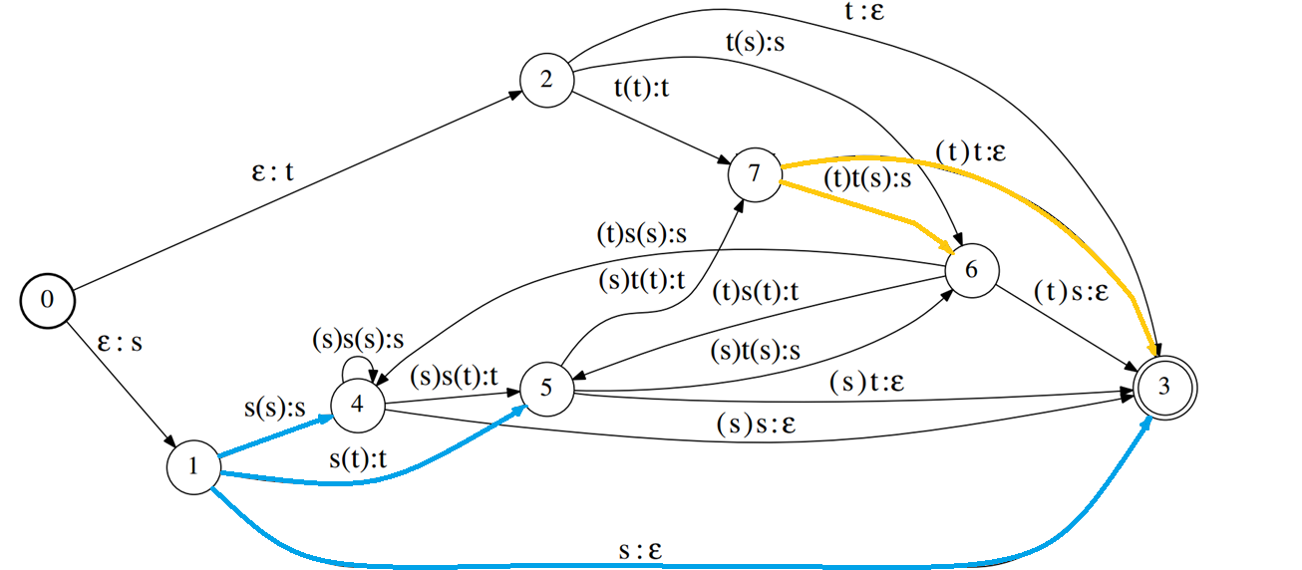
加速思路
搜索解码优化
减少 搜索复杂度
并行化 搜索算法
Parallel Computing
K + AA1 + R
CAR
Notes:
another way of thinking is we keep the search complexity unchanged, but we accelerate the search speed by parallel computing.
here the problem is to find the best path in a graph. We change this serial algorithm to parallel algorithm

Slide 50
基线解码算法
Weighted finite state transducer (WFST)
word | Pronunciation | Score¹
<s> | sil | 0.1
</s> | sil | 0.6
START | s t aa r t | 0.5
STOP | s t aa p | 0.4
IT | ih t | 0.3
每条边都有相应权重. 这里没有绘制出来
通常有百亿条边
Notes:
the latter process is done by WFST decoding. e.g., we have a lexicon like this and the langu model also gives some score for each word. Then we can express all these info as a graph.
【】Then the final problem becomes obtaining the best path in the graph, which is done by Viterbi decoding.

Slide 51
基线解码算法
词图处理
词图重估
置信度
混淆网络生成
etc.
鉴别性训练
Notes:
after decoding, we can obtain a nbest hypotheses list,
e.g. reading ..., read ...
and we can transfer it to a graph like this, as there are some common parts in the hypotheses, e.g. this "time"【】
It's called lattice.
After obtaining lattice, we can do several things 【】 Thus lattice processing is the common setup in ASR systems.
btw, this work can speed up all of these application by speeding up the decoding

Slide 52
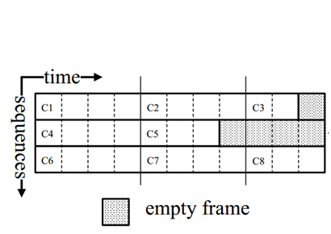
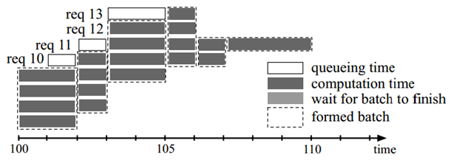
语音识别中的GPU应用
基于GPU的并行计算
矩阵运算
序列batching
训练阶段
推理阶段
Notes:
Parallel computing utilizes a large number of units to parallelize the computation
The matrix calculation and sequence batching are common to be sped up by it.

Slide 53
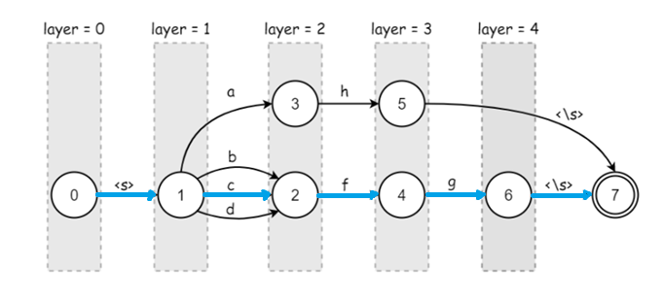

本工作的不同之处
This Work: GPU-based Decoding
Parallel WFST Decoding
Notes:
However, how to parallelize (pærəlelaɪz) the best path search algorithm is uncertain.

Slide 54


本工作的不同之处
This Work: GPU-based Decoding
Notes:
In this work, we change the serial decoding in CPU 【】 to parallel decoding in GPU【】

Slide 55

本工作的不同之处
This Work: GPU-based Decoding
GPU memory is enough for 1-pass WFST
Notes:
the whole pipeline is a 2-pass decoding. We generate 1-pass lattice in GPU, and do lattice rescoring in CPU. In this way, GPU memory is enough for 1-pass WFST.

Slide 56

框架介绍
Parallel Viterbi decoding in 3 levels
Future: out-going arcs, e.g. b, c & d
Notes:
The framework is parallel in the following 3 levels. first is future level. We search each out-going arcs, e.g. b c d【】 each with a separate GPU thread

Slide 57
框架介绍
Parallel Viterbi decoding in 3 levels
Future: out-going arcs, e.g. b, c & d
History: per state, e.g. 3 & 2
Notes:
we parallelize different histories. e.g. 3 and 2 can be processed by separate GPU threads.

Slide 58
框架介绍
Parallel Viterbi decoding in 3 levels
Future: out-going arcs, e.g. b, c & d
History: per state, e.g. 3 & 2
Utterance: decoding with separate GPU kernels
Notes:
Moreoever, different utterances can be processed with separate GPU kernels.
All these 3 levels, future, history, utterance, can be combined together.

Slide 59




问题1: 令牌合并
Token recombination
Language Model
Dictionary
DNN-HMM
（1）
Notes:
The first problem we need to solve is token recomb
The formula of Viterbi (VI TER BI) decoding is as formula 1. We combine 3 parts of knowledge to get the best path in the graph【】.

Slide 60


问题1: 令牌合并
Token recombination
（2）
Serial Viterbi Search
We need a
Thread Sync.
Parallel Viterbi Search
Notes:
the physical meaning of the max operation is as this figure. In each state, we remain only the best path to this state, which makes arcs in the WFST dependent with each other. Thus it is a serial algorithm
to change the serial alg to parallel alg, namely we make the search of 2 to 3 and 1 to 3 together, we need a thread sync in the state 3, to remain only the best one before continuing. Thus we abstract the max in the formula as a sync operation in the parallel computing

Slide 61

问题1: 令牌合并
Naïve implementation:
Critical section
Thread deadlock in earlier GPU architectures
Slow because of while loop and semaphore acquiring
Notes:
A naive implementation of this is adding critical section.
For each thread
we add semaphore (seməfɔ:(r))【】，do the comparison，store the better one, and then release semaphore【】
//by this way, each thread update the token information one by one.
This implementation has several problems here (WAIT a while)

Slide 62

问题1: 令牌合并
Problem:
Synchronization overhead in WFST states
Solution:
Single atomic operation¹
int64* atomicMax(*address, val) {
original = *address;
*address = max(val, *address);
return original;
}
1. atomicMax(*address, val). Computes max(*address, val), writes the result to address, and returns the original *address .
Notes:
we propose a better and unified solution with only one single atomic operation. An atomic operation do both comparison and store the maximum value to the address【】. And it is thread safe. Let's see an example.
for each arc, we have a score and its arc id, we pack them together.

Slide 63

问题1: 令牌合并
Problem:
Synchronization overhead in WFST states
Solution:
Single atomic operation¹
int64* atomicMax(*address, val) {
original = *address;
*address = max(val, *address);
return original;
}
1. atomicMax(*address, val). Computes max(*address, val), writes the result to address, and returns the original *address .
Notes:
In this exp, we have 4 in-going arcs, starting from arc 1. we packs score and arc id together. call an atomic operation. after that, the value of the state will be replaced by the pack value of arc 1, because the score is stored in the higher bits【】.

Slide 64

问题1: 令牌合并
Problem:
Synchronization overhead in WFST states
Solution:
Single atomic operation¹
int64* atomicMax(*address, val) {
original = *address;
*address = max(val, *address);
return original;
}
1. atomicMax(*address, val). Computes max(*address, val), writes the result to address, and returns the original *address .

Slide 65

问题1: 令牌合并
Problem:
Synchronization overhead in WFST states
Solution:
Single atomic operation¹
int64* atomicMax(*address, val) {
original = *address;
*address = max(val, *address);
return original;
}
1. atomicMax(*address, val). Computes max(*address, val), writes the result to address, and returns the original *address .

Slide 66

问题1: 令牌合并
Problem:
Synchronization overhead in WFST states
Solution:
Single atomic operation¹
int64* atomicMax(*address, val) {
original = *address;
*address = max(val, *address);
return original;
}
1. atomicMax(*address, val). Computes max(*address, val), writes the result to address, and returns the original *address .

Slide 67

问题1: 令牌合并
Problem:
Synchronization overhead in WFST states
Solution:
Single atomic operation¹
int64* atomicMax(*address, val) {
original = *address;
*address = max(val, *address);
return original;
}
1. atomicMax(*address, val). Computes max(*address, val), writes the result to address, and returns the original *address .
Notes:
practically, arc 2 and arc 4 are processed in parallel. But the atomic operation here garrentees that the final result is the best

Slide 68

问题1: 令牌合并
Problem:
Synchronization overhead in WFST states
Solution:
Single atomic operation¹
int64* atomicMax(*address, val) {
original = *address;
*address = max(val, *address);
return original;
}
1. atomicMax(*address, val). Computes max(*address, val), writes the result to address, and returns the original *address .
Notes:
after all updating, we have both the best score and the arc id it comes from.
And the whole algorithm is just like this example. for each thread, we pack the value, and then do an atomic operation

Slide 69
问题2: 负载均衡
Load imbalance: different num. of out-going arcs
1. In some word-end states, the number of arcs can be thousands
Notes:
The second problem is load imbalance.
e.g. there are 3 arcs out-going from state 1 and 2 arcs out-going from state 7. So we should allocate thread to arcs and states appropriately, else we will WAIT for some states, e.g. state 1, while other threads have finished processing, e.g. state 7.

Slide 70

问题2: 负载均衡
Group 0 with 32 threads
Token ?
Problem: diff. num. of out-going arcs
Solution: dynamic load balancing
Group 1 with 32 threads
Token ?
Notes:
We solve this problem by firstly allocate 32 threads to each group and now we have many groups, for exp, 2. And we need to allocate a state to each group. It is done by an atomic operation on the token index

Slide 71
问题2: 负载均衡
Group 0 with 32 threads
Token 0 in State 2
Problem: diff. num. of out-going arcs
Solution: dynamic load balancing
Group 1 with 32 threads
Token ?
Notes:
in this example, group 0 gets the token 0 at state 2

Slide 72
问题2: 负载均衡
Group 0 with 32 threads
Token 0 in State 2
Problem: diff. num. of out-going arcs
Solution: dynamic load balancing
Group 1 with 32 threads
Token 1 in State 1
Notes:
and group 1 get token 1 in state 1

Slide 73

问题2: 负载均衡
Group 0 with 32 threads
Token 0 in State 2
Problem: diff. num. of out-going arcs
Solution: dynamic load balancing
Group 1 with 32 threads
Token 1 in State 1
Notes:
once after allocating the index, group 0 and group 1 are working separately. e.g. thread 0 from group 0 process the arc from state 2 to state 3, and thread 1 process arc 2 to 6

Slide 74

问题2: 负载均衡
Group 0 with 32 threads
Token ?
Group 1 with 32 threads
Token 1 in State 1
Notes:
after all out-going arcs are processed, group 0 will request another token index

Slide 75

问题2: 负载均衡
Group 0 with 32 threads
Token ?
Group 1 with 32 threads
Token 1 in State 1

Slide 76

问题2: 负载均衡
Group 0 with 32 threads
Token 0 in State 2
Group 1 with 32 threads
Token ?
Notes:
if group 1 is finished. it will also request another token index separately

Slide 77
问题2: 负载均衡
Group 0 with 32 threads
Token ?
Group 1 with 32 threads
Token ?
Notes:
If both groups finish in the same time, the atomic operation still garrentees each index is allocated to a single group

Slide 78
问题2: 负载均衡
Why we use 32 threads/group？
Less → stuck in some states
More → waste threads
Problem: diff. num. of out-going arcs
Solution: dynamic load balancing
Expensive
Notes:
If we ,
Xx is xx
so

Slide 79

问题2: 负载均衡
Dynamic load balancing
Notes:
so the whole algorithm is as this example. it is based on atomic operation and group broacasting

Slide 80
问题3: 词图处理
Linkedlist → vector
Atomic operations
e.g. memory allocation
Parallel lattice generating and pruning ¹
1. Povey, Daniel, et al. "Generating exact lattices in the WFST framework." Acoustics, Speech and Signal Processing (ICASSP), 2012 IEEE International Conference on. IEEE, 2012.
Notes:
（Say more ）
The 3rd prob we need to solve is lat proc
Overall speaking, the exact lat algorithm proposed by Daniel Povey can be fully parallelized in GPU

Slide 81
实验结果
实验配置
Switchboard 300 hours corpus, Cross Entropy & LF-MMI acoustic models (AM)
30k-vocabulary, several tri-gram language models (LM)
基线系统
Kaldi 1-best decoder
Kaldi lattice decoder
GPU 实现优化¹
fast memcpy; merge GPU kernels by adding grid sync.; etc. (rel. 20% speedup)
1. https://github.com/chenzhehuai/kaldi/tree/gpu-decoder
Notes:
The experiments are conducted on swtichboard. We will quickly go over this part. For more details, please come to our oral session, and the details of GPU optimization can be referred to our source code.

Slide 82

实验结果
令牌合并的顺序改变
准确度性能
完全一致的最佳和词图性能
词图重估
置信度
混淆网络生成
etc.
鉴别性训练
Notes:
The comparison between CPU and GPU decoder firstly shows that they have the same performance both in 1-best and lattice quality. Notably, the lattice quality is verified by rescoring, oracle WER and confidence measure
recalling that lattice is important for most of the ASR modules
Based on the same pef, this framework can speed up all of them

Slide 83

实验结果
三阶段并行的加速效果
Our new number¹ is over 50X
1. https://github.com/chenzhehuai/kaldi/tree/gpu-decoder
Notes:
Based on the same performance, our 3-level parallelism achieve 34 times speedup
And our new number is over 50 times by better GPU optimization

Slide 84
实验结果
加速 → 节省费用
Decoding = 1 / RTF / Price
Device | Model | Threads | Price¹ ($/hour) | RTF | Decoding (hour/$)
CPU | E5-2686 v4 | 8 (1 socket) | 0.4 | 0.15 | 16.7
GPU | V100 | 163840 | 3.0 | 0.005 | 66.7
Save 4X budget
From Amazon AWS, 2018/04/23 https://aws.amazon.com/ec2/ ; m4.2xlarge v.s. p3.2xlarge
Notes:
Compared with utt level para comp in CPU, and if we take the price of CPU and GPU into account, the GPU decoder can still save 4x budget. Notably the GPU here is the newest one, thus it’s a little bit expensive

Slide 85

实验结果
兼容性
GPU arch.
WFST size
Acoustic model

Slide 86

实验结果
Enough for 1-pass WFST
GPU内存 v.s. WFST大小

Slide 87

实验结果
计算时间占比分析
Notes:
No explicit bottleneck

Slide 88
提纲
课题背景
语音识别中的序列建模
语音识别中的搜索解码
无词图的序列鉴别性训练
并行化的搜索解码算法
标签同步的搜索解码算法

Slide 89

基于深度学习的语音识别
DNN-HMM
Deep learning: observation probability modeling
HMM: temporal correlation modeling

Slide 90
端到端的语音识别
初衷
更强的分类器
和更多的数据
更好的序列建模能力
直接建模
音素/字形/词语
K + AA1 + R
CAR
C + A + R
Notes:
the motivation of e2e sr is that, we have ... , so
e.g.
previously we obtain phone seq from feature seq and then obtain word seq from feature seq
e2e refer to model word seq directly
another choice is to model the character seq directly

Slide 91
端到端的语音识别
初衷
更强的分类器和更多的数据
更好的序列建模能力
直接建模音素/字形/词语
Tri-phone HMM state
sil-K+AA1[0-4] + K-AA1+R[0-4] + AA1-R+sil[0-4]
K + AA1 + R
Mono-phone
Notes:
practically, we model tri-phone HMM state seq from feature seq, and if we model the phone seq directly, which contains only 3 units, it can also be regarded as end-to-end modeling

Slide 92


连接时序分类模型（CTC）
From HMM to CTC: do better in sequential modeling
CTC model: learn the state mapping with blank state
Per-phoneme:
Notes:
CTC model is proposed to give better sequential modeling effects.
in hmm, each hidden state only depends on the last state, and each feature input is depend on one hidden state. it is a generative model
CTC is a discriminative model. here each hidden state is depend on the whole feature sequence
as it has stronger sequential modeling effect, the criterion of CTC tries to learn the state mapping with blank state.
here is an exp. in HMM, we have five states to represent a phoneme
in CTC, we still have five states, but two blank states are skippable, the entry and exit states do not relate to the phoneme we are modeling. So we actually model one phoneme with one single phoneme specific state, which is called end-to-end modeling

Slide 93

基于HMM与CTC的声学模型比较
Peaky distribution & concentrated outputs
Notes:
if we examine the inference distribution of CTC models, it shows peaky property.
here the horizon axis is the time axis and the vertical axis is the probability.
one color denotes a phoneme. e.g. we look at the red line, which denotes the phoneme w
in HMM, it lasts for a long time span as it has five HMM states and normally distribute in average.
but CTC in the 3rd line only outputs a single peak in the corresponding long span. and most of the span is blank outputs
besides, in the figure we can find that during the long span, there is no phonemic output in CTC. therefore it's of no use to integrate language model. in other word, the search / decoding process in such span is of no need.

Slide 94
由逐帧同步到标签同步
Frame synchronous Viterbi beam search in CTC
(1)
LM
AM
Corresponding phone seq.
Notes:
Here, we formulate our motivation to propose the phone synchronous decoding
the formulation of traditional fr sync decoding, that is FSD, is as here. this is bayesian therom and we combine LM and AM knowledge sources.

Slide 95


由逐帧同步到标签同步
Frame synchronous Viterbi beam search in CTC
(1)
(2)
Frame de-composition
(3)
Notes:
after a frame decomposition, here the product is regarding to T frames
the key point is that in FSD the searching iteration is regarding to frames T(in the formula), which means that searching is done during all the long span (in the figure), because phonemic output is along the whole time axis

Slide 96





由逐帧同步到标签同步
Frame sync. to label synchronous decoding
(1)
(2)
(3)
(5)
(4)
(7)
(6)
Notes:
in PSD, we divide the frames T into 2 parts, firstly blank frames and secondly phonemic frames (in the formula)
and we can prove that the blank frames part can be ignored:
1stly, blank label will not change the output of B
and 2ndly, 【blank frame refers to the frame whose blank posterior is approaching 1】, so we are confirmed it is blank frame
therefore, the probability mass can be ignored because it's almost 1
then finally, the search in PSD is transformed to regard to phones J (in the formula),【 which also refers to the peaks (in the figure)】

Slide 97


由逐帧同步到标签同步
Notes:
the algorithm is quite elegant. in each frame, we decide whether it is blank frame or phoneme frame. if it is blank frame, we just ignore it, if it is phoneme frame, we keep it and do the original viterbi decoding.
and phisically in the figure, it just refers to the fact that we ignore the blank parts and decode the phoneme parts

Slide 98


复杂度变化分析
Frame synchronous decoding
Label synchronous decoding
where we usually have
T:U = 10:1
Notes:
it can be directly learned from the figure that huge searching can be saved.
if we analyze the search complexity. previously, the complexity regards to the length of the utterance T, the size of the phoneme set and the size of the vocabulary
now it does not regard to the length T, but only the length of the phoneme sequence.
thus the complexity is significantly reduced

Slide 99
实验结果
实验配置
Switchboard 300 hours corpus, 2.5-3M parameters
30k-vocabulary, several tri-gram language models (LM)
Notes:
No details

Slide 100

实验结果
CTC中的搜索解码加速
在不损失WER情况下取得 3倍 加速
我们在中文上取得了更显著的加速
3~5 times speedup
Notes:
with similar performance, we achieve three-time speedup
due to the time limit, we have to skip other experiment details

Slide 101

实验结果
与跳帧方法对比
工作在不同层面，可叠加
Notes:
with similar performance, we achieve three-time speedup
due to the time limit, we have to skip other experiment details

Slide 102


CTC音素词图 – 一种紧致的声学表示
Notes:
and finally, this framework can also be used in other ASR modules

Slide 103



CTC音素词图 – 一种紧致的声学表示
Oracle phone error rate
103
Notes:
and finally, this framework can also be used in other ASR modules

Slide 104
CTC音素词图的扩展应用
无词图鉴别性训练 (chain model)
关键词检测
置信度
声学特征到词语的端到端建模
Zhehuai Chen, Yimeng Zhuang, Yanmin Qian and Kai Yu, Phone Synchronous Speech Recognition with CTC Lattices, IEEE/ACM Transactions on Audio, Speech, and Language Processing , vol. 25, no. 1, pp. 86-97, Jan. 2017. doi: 10.1109/TASLP.2016.2625459
Zhehuai Chen, Qi Liu, Hao Li, Kai Yu, On Modular Training of Neural Acoustics-to-word Model for LVCSR, IEEE International Conference on Acoustics, Speech and Signal Processing(ICASSP), Calgary, Canada, 2018.
Zhehuai Chen, Yanmin Qian, and Kai Yu. A unified confidence measure framework using auxiliary normalization graph, IScIDE, 2017.
Zhehuai Chen, Yimeng Zhuang and Kai Yu, Confidence Measures for CTC-based Phone Synchronous Decoding, IEEE International Conference on Acoustics, Speech and Signal Processing(ICASSP), New Orleans, USA, 2017: 4850-4854. [student travel grant]
Zhehuai Chen, Wei Deng, Tao Xu and Kai Yu. Phone Synchronous Decoding with CTC Lattice. 17th Annual Conference of the International Speech Communication Association (InterSpeech), San Francisco, America, 2016: 1923-1927.[student travel grant]
Notes:
and finally, this framework can also be used in other ASR modules

Slide 105


例子：关键词检测
Framework
A minimum edit distance based post-processing
Notes:
and finally, this framework can also be used in other ASR modules

Slide 106
总结
语音识别的序列建模
提出多说话人重叠语音识别的无词图鉴别性训练
在双人重叠英文电话语音识别中取得了8%的性能提升
提出关键词检测的无词图鉴别性训练
在关键词检测和语音唤醒任务上取得了17%的性能提升
语音识别的搜索解码
提出并行化的维特比解码算法，以提高计算速度
在英文电话语音识别中取得了46倍的速度提升，并开源算法
提出标签同步的维特比解码算法，以降低计算复杂度
在英文电话语音识别中取得了3-5倍的速度提升
LSD音素词图可拓展到关键词检测，置信度，端到端语音识别中
Notes:
My published works

Slide 107
第一作者文章（12篇）
Transaction:
Zhehuai Chen, Yanmin Qian, Kai Yu, Sequence Discriminative Training for Deep Learning based Acoustic Keyword Spotting, 2018, accepted by Speech Communication.
Zhehuai Chen, Jasha Droppo, Jinyu Li, Wayne Xiong, Progressive Joint Modeling in Unsupervised Single-channel Overlapped Speech Recognition. IEEE/ACM Transactions on Audio, Speech, and Language Processing, vol. 26, no. 1, pp. 184-196, Jan. 2018. doi: 10.1109/TASLP.2017.2765834.
Zhehuai Chen, Yimeng Zhuang, Yanmin Qian and Kai Yu, Phone Synchronous Speech Recognition with CTC Lattices, IEEE/ACM Transactions on Audio, Speech, and Language Processing , vol. 25, no. 1, pp. 86-97, Jan. 2017. doi: 10.1109/TASLP.2016.2625459
Conference:
Zhehuai Chen, Mahaveer Jain, Yongqiang Wang, Michael Seltzer, Christian Fuegen, End-to-end Contextual Spebech Recognition using Class Language Models and a Token Passing Decoder, IEEE International Conference on Acoustics, Speech and Signal Processing (ICASSP), Brighton, UK, 2019.
Zhehuai Chen, Justin Luitjens, Hainan Xu, Yiming Wang, Daniel Povey, Sanjeev Khudanpur, A GPU-based WFST Decoder with Exact Lattice Generation, accepted by 19th Annual Conference of the International Speech Communication Association, 2018. [Best Paper Nomination]
Zhehuai Chen, Linguistic Search Optimization for Deep Learning Based LVCSR, in Doctoral Consortium, 19th Annual Conference of International Speech Communication Association (InterSpeech), 2018.
Zhehuai Chen, Jasha Droppo, Sequence Modeling in Unsupervised Single-channel Overlapped Speech Recognition, IEEE International Conference on Acoustics, Speech and Signal Processing(ICASSP), Calgary, Canada, 2018.
Zhehuai Chen, Qi Liu, Hao Li, Kai Yu, On Modular Training of Neural Acoustics-to-word Model for LVCSR, IEEE International Conference on Acoustics, Speech and Signal Processing(ICASSP), Calgary, Canada, 2018.
Zhehuai Chen, Yanmin Qian, and Kai Yu. A unified confidence measure framework using auxiliary normalization graph, IScIDE, 2017.
Notes:
这是博士期间发表的一作文章

Slide 108
第一作者文章（12篇）
Zhehuai Chen, Yimeng Zhuang and Kai Yu, Confidence Measures for CTC-based Phone Synchronous Decoding, IEEE International Conference on Acoustics, Speech and Signal Processing(ICASSP), New Orleans, USA, 2017: 4850-4854. [student travel grant]
Zhehuai Chen, Wei Deng, Tao Xu and Kai Yu. Phone Synchronous Decoding with CTC Lattice. 17th Annual Conference of the International Speech Communication Association (InterSpeech), San Francisco, America, 2016: 1923-1927.[student travel grant]
Zhehuai Chen and Kai Yu, An Investigation of Implementation and Performance Analysis of DNN Based Speech Synthesis System. 12th IEEE International Conference on Signal Processing(ICSP), Hangzhou, 2014: 577-582.
其他文章
Mingkun Huang, Yongbin You, Zhehuai Chen, Yanmin Qian, Kai Yu. Knowledge Distillation for Sequence Model, 19th Annual Conference of International Speech Communication Association (InterSpeech), 2018.
Yue Wu, Tianxing He, Zhehuai Chen, Yanmin Qian and Kai Yu. Multi-view LSTM Language Model with Word-synchronized Auxiliary Feature for LVCSR, CCL, 2017.
Da Zheng, Zhehuai Chen, Yue Wu, Kai Yu, Directed Automatic Speech Transcription Error Correction Using Bidirectional LSTM. International Symposium on Chinese Spoken Language Processing (ISCSLP), Tianjin, China, 2016.
Bo Chen, Zhehuai Chen, Jiachen Xu, Kai Yu. An Investigation of Context Clustering for Statistical Speech Synthesis with Deep Neural Network. 16th Annual Conference of the International Speech Communication Association (InterSpeech), Dresden, Germany, 2015.
Notes:
这是博士期间发表的一作文章

Slide 109



专利
PCT/CN2016/081334 voice recognition based decoding method and device
CN201710343427.5 Sequence discriminative training based wakeup word device
CN201810054749.2 lattice rescoring system of deep learning based language model4.
CN201710561261.4 self-tagging, single direction and multi-view language modeling
CN201610221182.4 a decoding method and device of speech recognition
CN201610462976.X adapative wakeup word method and device
CN201810025834.6 an audio recognition method and device
CN201810054315.2 a speech recognition method and device
CN201710060942.2 confidence measure based speech recognition method and device
CN201810021903.6 model compression and optimization of speech recognition device
实际应用
Notes:
这是博士期间发表的一作文章

Slide 110
Appendix

Slide 111
PIT

Slide 112

Our solution
Acoustics
Modular Initialization 4%
CNN 10%
Transfer Learning Based Joint Training 20%
Temporal Correlation Modeling 8%
Linguistics
Multi-outputs Sequence Discriminative Training 8%
Integrating Language Model in Assignment Decision 4%
Notes:
We propose a series of techniques to improve the system, the red number denotes how much it can be improved. Due to the time limit, we only focus on the discriminative training part

Slide 113

PIT + Transfer Learning
Modularization
Transfer Learning
To solve the distribution mismatch
problem in feature space
Model: speech-to-text module
Source domain: clean speech
Target domain: output of speaker
tracing module (enhanced feat.)

Slide 114

PIT + Transfer Learning
Clean infer.
PIT model infer.

Slide 115

Acoustics - Transfer Learning x Joint Training
Advantages
Domain adaptation v.s. from scratch
Better model convergence

Slide 116
Our solution
Acoustics
Modular Initialization 4%
CNN 10%
Transfer Learning Based Joint Training 20%
Temporal Correlation Modeling 8%
Linguistics
Multi-outputs Sequence Discriminative Training 8%
Integrating Language Model in Assignment Decision 4%

Slide 117
PSD

Slide 118


Slide 119


Slide 120


Slide 121
Other PSD

Slide 122



Slide 123
GPU details

Slide 124

Procedure of WFST decoding
Loops until no token modification

Slide 125

Lattice processing
Lattice pruning
The original CPU version: iteratively updates extra costs of nodes and arcs until they stop changing
Proposed:
updating in parallel
Linkedlist → vector
Atomic operations

Slide 126

Speed and memory optimization
share WFST between utterances in a GPU
reduce context switching overheads: multi-process service (MPS)
Lazy malloc to reduce memory: CudaMallocManaged
grid sync implementation

Slide 127

Speed and memory optimization
reduce grid sync using multiple copy of variable
Do not need to make threads wait for modified1 = false

Slide 128

Speed and memory optimization
reduce grid sync using multiple copy of variable
faster atomicAdd by launch-and-go
sharing atomicAdd
fast copy

